Slide 1
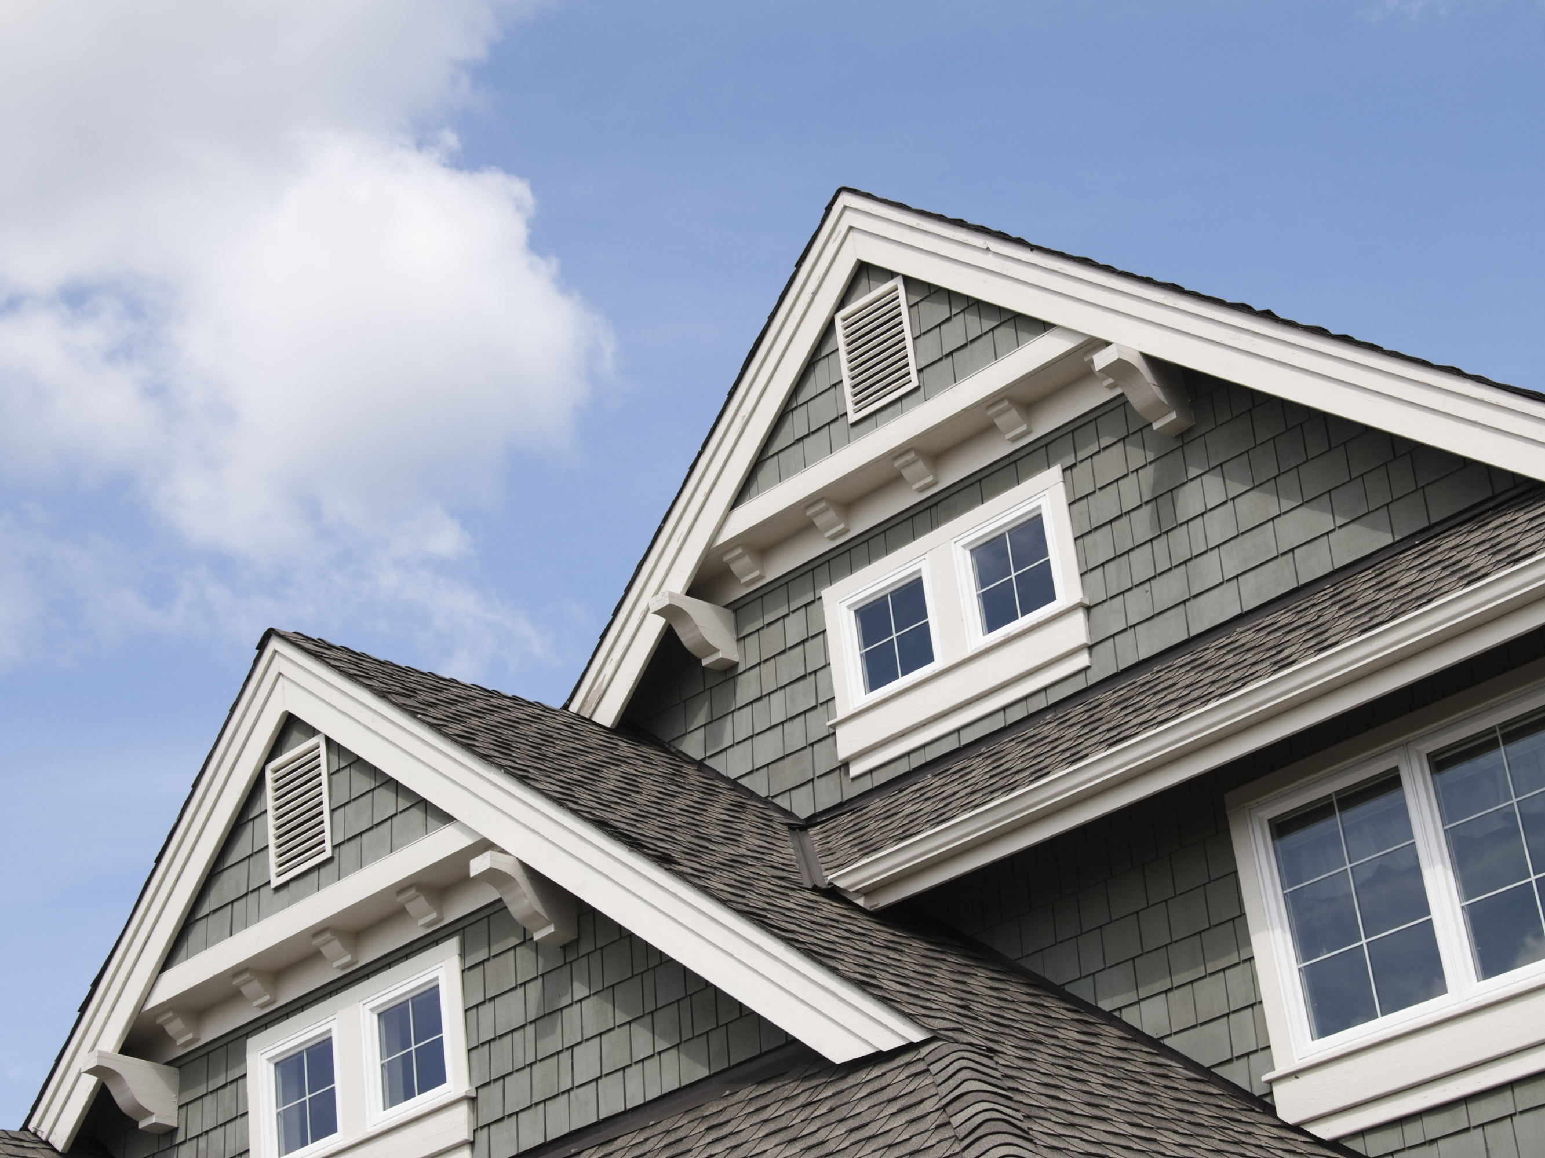
House Pricing with Machine Learning
Salih Birdal
20210205026

Slide 2

Introduction
In recent years, the rapid advancements in Machine Learning (ML) have led to the widespread adoption of this technology across many industries. One of the key domains where ML has been effectively applied is the real estate sector, particularly in house price prediction. The steady increase in housing prices each year has made it essential to accurately estimate property values for both individual buyers and investors. The predictive models developed in this context not only help customers identify homes that meet their needs but also assist real estate stakeholders in analyzing market dynamics and making strategic decisions.
Moreover, the integration of data mining techniques into the housing market has significantly expanded in recent years. These techniques, which enable the extraction of meaningful information from large and unstructured datasets, are effectively used in various tasks such as predicting house prices, identifying key housing attributes, and analyzing market trends. Features such as the number of bedrooms, age of the house, accessibility, proximity to schools, and nearby shopping centers are evaluated by ML algorithms to support more accurate property valuations. Numerous studies in the literature emphasize that fluctuations in house prices are a critical concern affecting both individuals and the broader market, thereby highlighting the growing need for reliable prediction models.
This study presents a comprehensive approach to house price prediction using supervised learning techniques. The implementation process is carried out using two different datasets: the first is the "House Prices – Advanced Regression Techniques" dataset from a competition hosted on the Kaggle platform, and the second is the "California House Price" dataset, which includes property values from the state of California. On datasets, data preprocessing, exploratory data analysis (EDA), and feature engineering steps were performed, followed by the training of various machine learning models with hyperparameter optimization. The aim of this study is to compare the performance of these models to determine which one yields the highest accuracy in predicting house prices and to analyze the effectiveness of the applied techniques.

Slide 3

Literature Review
the increasing demand for accurate and interpretable house price prediction systems has led to the widespread application of machine learning algorithms in the real estate domain. Several studies have examined various techniques, datasets, and feature engineering methods to determine the most efficient approaches for predicting property values under changing market conditions.
One significant study focused on modeling house prices based on structural and locational features such as the number of bedrooms, age of the house, transportation accessibility, proximity to schools, and availability of nearby shopping malls. Implemented using Scikit-learn, the study applied decision tree classification, decision tree regression, and multiple linear regression models for a localized housing dataset in West Godavari, Andhra Pradesh, India, demonstrating the practical value of interpretable, rule-based models in small-town contexts (Thamarai & Malarvizhi, n.d.).
In another comprehensive survey, Zulkifley et al. (n.d.) explored the most influential features and machine learning algorithms for house price forecasting. Their findings concluded that Artificial Neural Networks (ANN), Support Vector Regression (SVR), and XGBoost produced superior predictive performance compared to other algorithms. The study emphasized the importance of location and structural attributes, confirming their dominant role in model accuracy and underlining the benefit of such models for both researchers and housing developers.
Adetunji et al. (n.d.) shifted the focus from predicting exact house prices to estimating a range of possible values, arguing that this approach is more realistic for many practical applications. Their study used the Random Forest algorithm on the Boston Housing dataset from the UCI Machine Learning Repository, demonstrating that their model could predict within a margin of ±5% of actual prices. The authors also criticized the House Price Index (HPI) as a generalized estimator, inadequate for single-house price prediction due to its aggregated nature based on repeat sales.
Similarly, Park and Bae (n.d.) developed a machine learning-based housing price prediction model using a dataset of 5,359 townhouses from Fairfax County, Virginia. By evaluating several algorithms—C4.5, RIPPER, Naïve Bayes, and AdaBoost—they found that the RIPPER algorithm consistently outperformed others in classification accuracy. Their study underlined the practical value of such models for real estate agents and homeowners in making informed pricing decisions.
Truong et al. (2019) also highlighted that while many studies adopt traditional machine learning techniques, they often neglect complex or less popular algorithms. Their work compared the performance of both conventional and advanced models and validated several combinations to achieve optimized housing price predictions. Collectively, these studies confirm that machine learning methods—when properly tuned and combined with meaningful feature selection—can significantly improve house price forecasting. They also highlight the evolving trend from traditional, linear models to more flexible and ensemble-based algorithms capable of handling the inherent complexities of real-world housing data.
This study uses machine learning algorithms as a research methodology to develop a housing price prediction model. To improve the accuracy of housing price prediction, this paper ana lyzes the housing data of 5359 townhouses in Fairfax County, Virginia, gathered by the Multiple Listing Service (MLS) of the Metropolitan Regional Information Systems (MRIS). We develop a housing price pre diction model based on machine learning algorithms such as C4.5, RIPPER, Naïve Bayesian, and AdaBoost and compare their classification accuracy performance. We then propose an improved housing price pre diction model to assist a house seller or a real estate agent make better informed decisions based on house price valuation. The experiments demonstrate that the RIPPER algorithm, based on accuracy, con sistently outperforms the other models in the performance of housing price prediction. ( Park, B., & Bae, J. K.)

Slide 4
House Pricing with Machine Learning
California House Prices
House Prices – Advanced Regression Technique

Slide 5
California House Prices
The US Census Bureau has published California Census Data which has 10 types of metrics such as the population, median income, median housing price, and so on for each block group in California. The dataset also serves as an input for project scoping and tries to specify the functional and nonfunctional r requirements for it.
The project aims at building a model of housing prices to predict median house values in California using the provided dataset. This model should learn from the data and be able to predict the median housing price in any district, given all the other metrics.
Districts or block groups are the smallest geographical units for which the US Census Bureau publishes sample data (a block group typically has a population of 600 to 3,000 people). There are 20,640 districts in the project dataset.

Slide 6
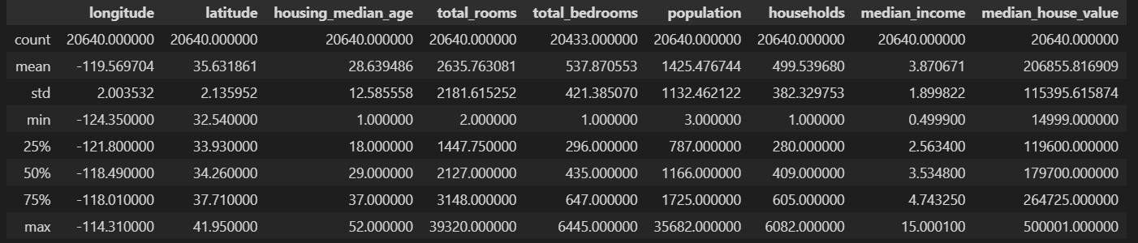
California House Prices – Preprocessing
In the preprocessing phase, several essential steps were undertaken to ensure the integrity and quality of the dataset. Initially, a descriptive analysis (Fig. 1) was conducted to understand the central tendency and dispersion of variables. It was observed that the "total_bedrooms" feature had a missing rate of approximately 1.0029%. Missing values were imputed using the mean imputation strategy to preserve dataset size and minimize variance distortion.

Slide 7
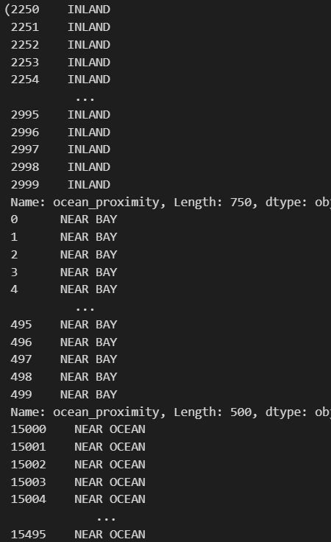
California House Prices – Preprocessing
During initial observations, the "ocean_proximity" categorical feature exhibited a suspicious distribution. For example, the first 50 rows consistently had the value "NEAR BAY", and rows indexed between 2,250 and 3,000 had the value "INLAND". Moreover, different index ranges (e.g., 15,000–15,500) were also associated with repetitive "NEAR OCEAN" values. This observation suggested that the dataset may not have been properly randomized. Thus, a random shuffle (Fig. 2) was applied to eliminate any potential ordering bias and to ensure that subsequent training and validation steps received statistically representative samples.

Slide 8
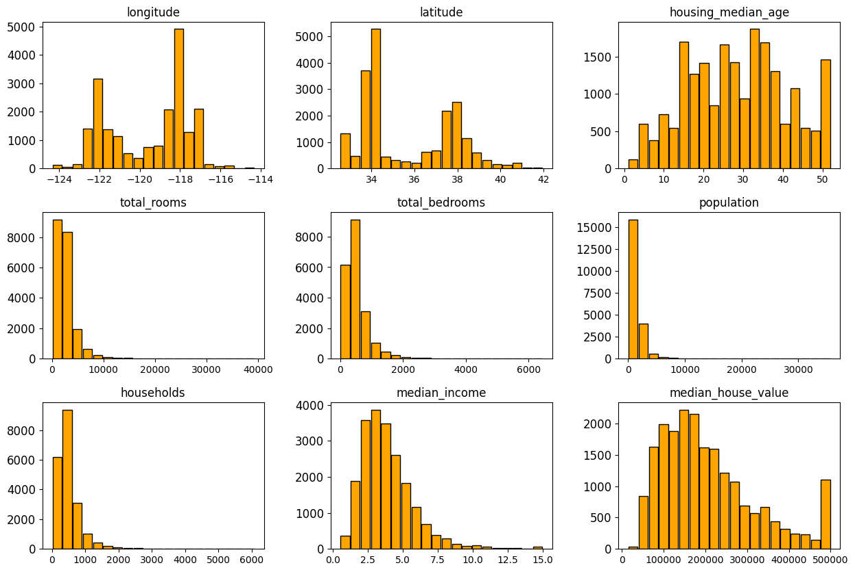
California House Prices – Visual1 for EDA
As shown in Fig. 3, most numerical features such as total_rooms, population, households, and median_income exhibit right-skewed distributions, indicating the presence of high-value outliers. For instance, the total_rooms and total_bedrooms features display long right tails, implying a concentration of low-to-moderate values with a few extreme cases. Similarly, the target variable itself, median_house_value, also shows a skewed distribution that may affect model accuracy if not handled appropriately.

Slide 9
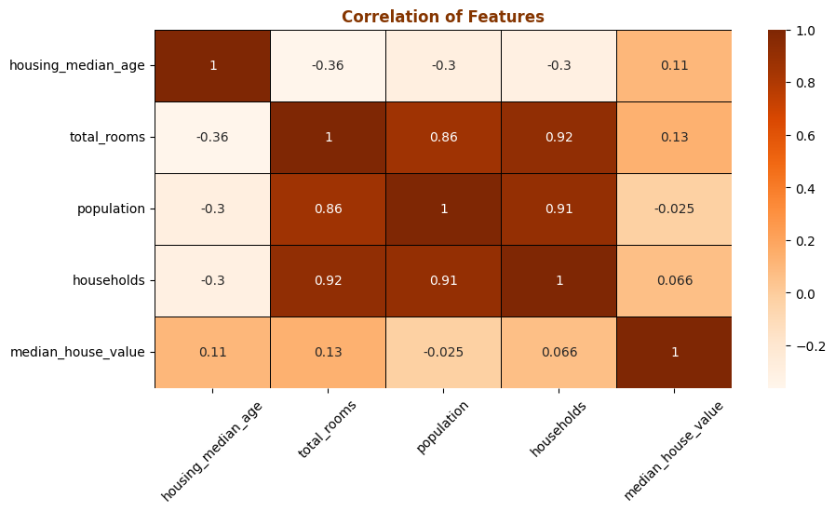
California House Prices – Visual 2 for EDA
To evaluate feature interdependencies, a correlation matrix was constructed (Fig. 4). The analysis revealed a strong multicollinearity between features such as total_rooms, population, and households (correlation coefficients > 0.9). This implies that these variables likely capture overlapping information and may contribute to model overfitting if not regularized or pruned. In contrast, the target variable showed relatively weak correlation values with individual features, indicating the necessity of non-linear or ensemble models to capture complex relationships in the data.

Slide 10
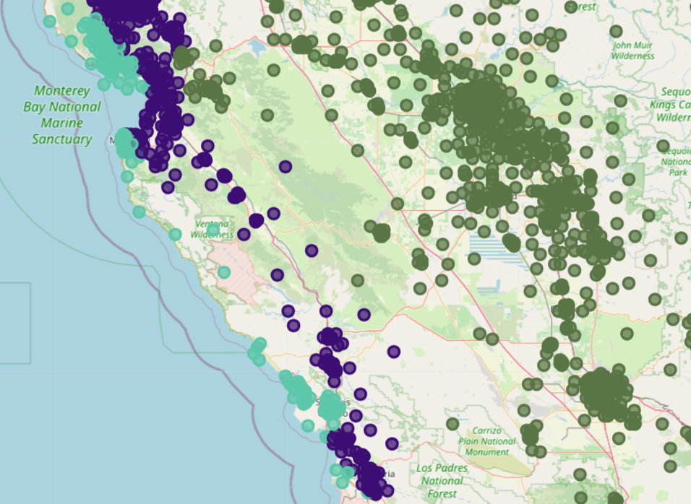
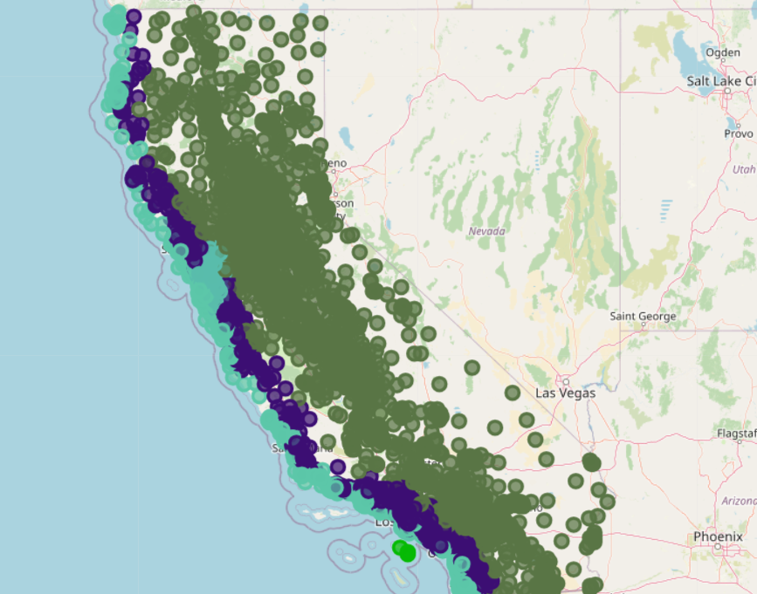
California House Prices – Visual 3 for EDA
To explore the spatial distribution of the ocean_proximity feature and assess its geographical consistency, a geospatial plot was generated using Folium. The map visualization revealed distinct regional clustering patterns corresponding to different proximity categories. For instance, "NEAR BAY" and "NEAR OCEAN" labels were predominantly observed along the western coastal strip, while "INLAND" classifications were concentrated further eastward, away from the coastline. I will shoe you end of the slide.

Slide 11
House Prices – Advanced Regression Technique
With 79 explanatory variables describing (almost) every aspect of residential homes in Ames, Iowa, this competition challenges you to predict the final price of each home. (Kaggle – Advanced House Regression Technique)
SalePrice - the property's sale price in dollars. This is the target variable that you're trying to predict.
MSSubClass: The building class
MSZoning: The general zoning classification
LotFrontage: Linear feet of street connected to property

Slide 12
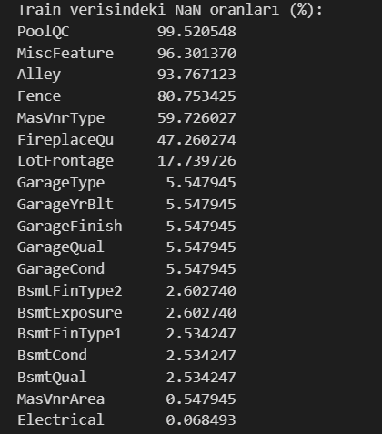
House Prices – Advanced Regression Technique Preprocessing
Initially, the ratio of missing values in each column was calculated (Fig. 6). Based on this analysis, variables with null inputs were evaluated according to data types. columns greater than 15% were deleted from the data. Categorical variables were determined using the mode representing the most frequently used category in each property. In contrast, numerical variables were filled in using the median value to reduce the effect of excessive values and maintain the central trend without inflating the variance.

Slide 13
House Prices – Advanced Regression Technique Preprocessing
To normalize the scale of continuous variables that exhibit large magnitude differences, feature scaling was applied to selected variables including LotArea, GrLivArea, and TotalSF. Standard scaling techniques were employed to prevent dominance of high-magnitude features during model training and to improve algorithmic convergence, especially for gradient-based learning methods.
Outlier detection was applied to all integer-type (int64) features using the Interquartile Range (IQR) method. For each column, values below Q1−1.5×IQRQ1 - 1.5 \times IQRQ1−1.5×IQR or above Q3+1.5×IQRQ3 + 1.5 \times IQRQ3+1.5×IQR were identified as outliers. Instead of removal, a capping strategy was used—values were replaced with the corresponding lower or upper bounds. This approach reduced the impact of extreme values while preserving dataset integrity.
Feature engineering was performed to enhance model performance by generating informative composite variables. Specifically, TotalSF was created as the sum of all floor areas, while HouseAge and RemodAge were derived to capture the age of the property and the time since its last renovation, respectively.

Slide 14
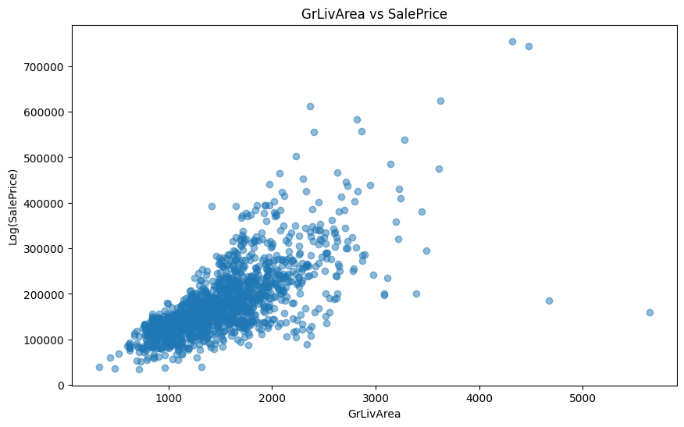
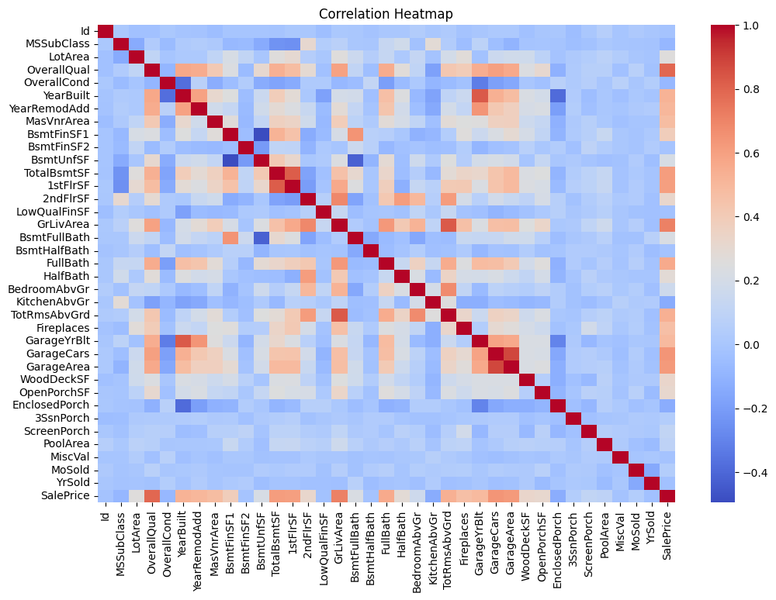
House Prices – Advanced for Regression Visual 1,2 for EDA
A correlation heatmap was generated to identify linear relationships among variables, highlighting strong positive correlations between features such as GrLivArea and SalePrice. Additionally, a scatter plot confirmed a clear positive association between these two variables, indicating that increased above-ground living area tends to correspond with higher sale prices.

Slide 15
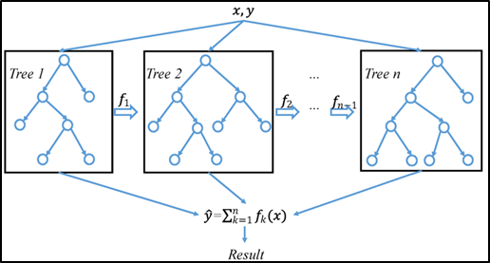
Modelling
XGBoost
Catboost
RandomForest

Slide 16
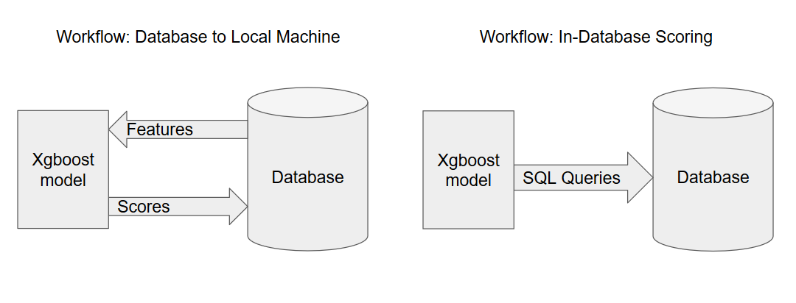
XGBoost
Extreme Gradient Boosting (XGBoost) is a scalable and efficient implementation of gradient boosted decision trees. Known for its outstanding performance in a wide range of machine learning competitions and real-world applications, XGBoost offers excellent scalability in both memory-limited and distributed computing environments. It achieves this through optimized usage of system resources and algorithmic innovations such as regularization, parallel tree construction, and cache awareness. In this study, XGBoost outperformed the other models in both RMSE and R² score, demonstrating its strength in learning complex, non-linear patterns from data.
Bu Fotoğraf, Bilinmeyen Yazar, CC BY-NC altında lisanslanmıştır

Slide 17
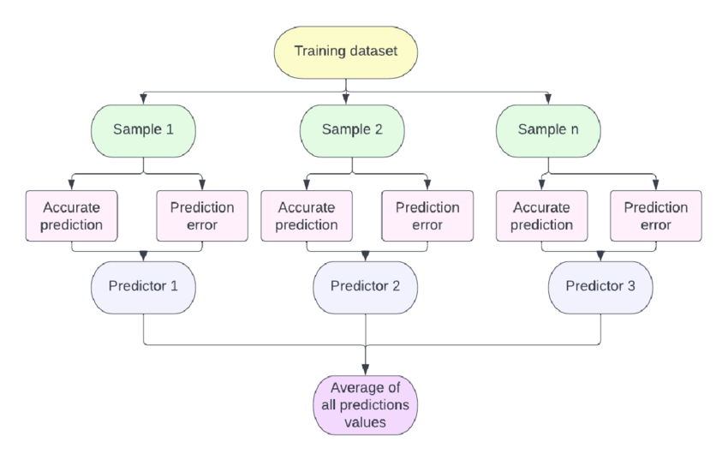
Catboost
CatBoost, short for Categorical Boosting, is a gradient boosting algorithm developed by Yandex. It builds an ensemble of decision trees sequentially, where each tree aims to reduce the errors made by the previous trees. In gradient boosting, the model does not alter earlier trees but instead uses their outcomes to improve future ones. The main innovation in CatBoost lies in how it handles categorical features internally and how it reduces overfitting by employing ordered boosting and symmetric tree structures. In this method, the same splitting function is used for both left and right branches at each tree level, which enhances computational efficiency and generalization ability. (Park & Bae)

Slide 18
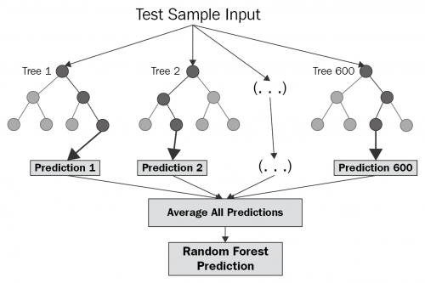
Randomforest
Random Forest is an ensemble learning method that combines the predictions of multiple decision trees to generate a more robust and accurate final prediction. Unlike boosting methods, which build trees sequentially, Random Forest trains multiple trees independently on bootstrapped subsets of the data. The final prediction is typically obtained through averaging (in regression tasks), which helps to reduce variance and avoid overfitting. While Random Forest is generally reliable and interpretable, its performance in this study was comparatively lower, especially in terms of R² score. (Thamarai & Malarvizhi, n.d.)
Bu Fotoğraf, Bilinmeyen Yazar, CC BY-SA-NC altında lisanslanmıştır

Slide 19

Evaluation
Mean Absolute Error (MAE) is a frequently employed metric. It's a measurement of the typical absolute discrepancies between a dataset's actual values and projected values.
RMSE It quantifies the percentage of the dependent variable's variation that the model's independent variables contribute to.
RMSE It is a usually used metric in regression analysis and machine learning to measure the accuracy or goodness of fit of a predictive model, especially when the predictions are continuous numerical values.

Slide 20
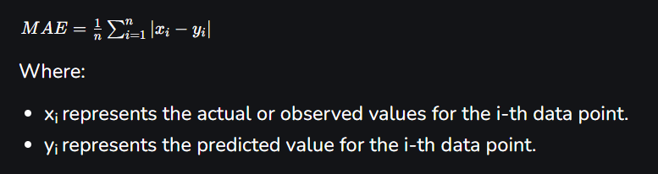
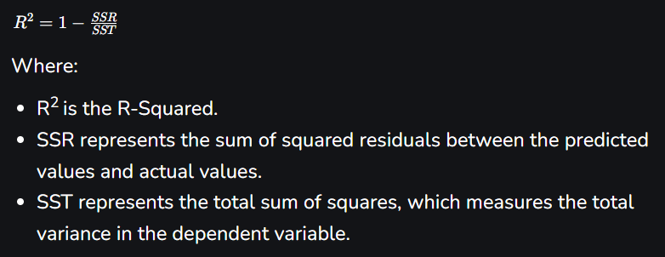
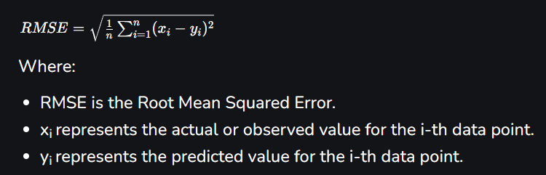
Evaluation Fromulas

Slide 21
Hyperparameter Optimization
Hyperparameter tuning is the process of selecting the optimal values for a machine learning model’s hyperparameters. Hyperparameters are configuration settings that control the learning process of the model.
Advantages of Hyperparameter tuning
Improved Model Performance: Finding the optimal combination of hyperparameters can significantly boost model accuracy and robustness.
Reduced Overfitting and Underfitting: Tuning helps to prevent both overfitting and underfitting resulting in a well-balanced model.

Slide 22
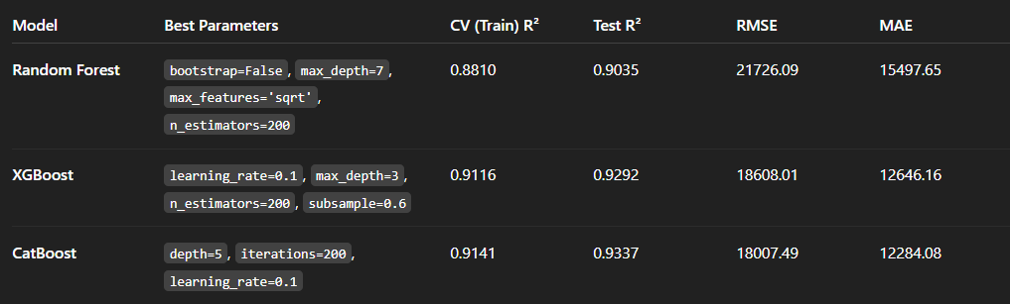
Results – House Prices Advanced Regression

Slide 23
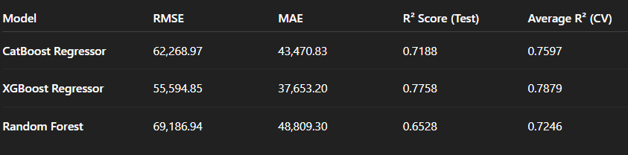
Results – California Dataset

Slide 24

Thank you Salih Birdal Information System Engineering Student

